Slide 1

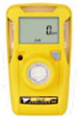
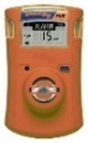
Manure Gas Safety
Why should I be concerned about manure gas hazards?
Hydrogen sulfide exposures have killed livestock and farmers
People cannot smell when concentrations are dangerous
Hydrogen sulfide concentrations can increase quickly
What can I do to reduce H₂S risk?
Monitors to measure hydrogen sulfide gas concentrations identify the risk in real time
Bump test the hydrogen sulfide monitor 2 weeks before and the start of the day you plan to do hazardous activities
Wear your hydrogen sulfide monitor near head or clipped onto collar
Turn on ventilation fans before manure handling activities
Monitor Types
BW Clip Real Time
SGC Plus
Shows concentration of H₂S gas
Lasts 2 years (hibernation case may extend lifetime)
Shows months remaining; shows concentration when H₂S is present
Lasts 2 years (IR link may extend lifetime)
Both vibrate, flash, and alarm
slow for low alarm
fast for high alarm

Slide 2
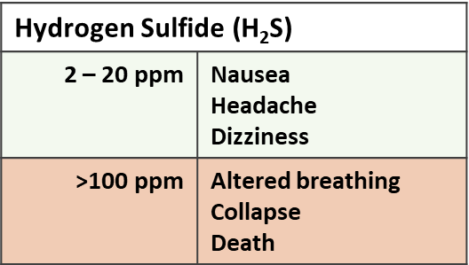


Monitor Use
High concentrations have been identified:
When pumping manure, inside and outside of buildings
After pumping is complete, inside buildings
During pressure washing
Inside full and empty manure storage pits
In unvented spaces with decaying materials
When hauling and land-applying manure
Wear H₂S monitor in high concentration areas
Monitors alarm when concentrations reach levels that cause long-term health effects.
If monitor is alarming, ventilate the area and pay attention to concentration displayed on screen
Leave area immediately at 50 ppm
Concentrations may be deadly if monitor reads 100 ppm
What Do the Numbers Mean?
For more, visit: www.gpcah.org

