Slide 1

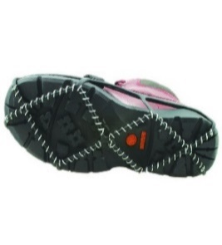
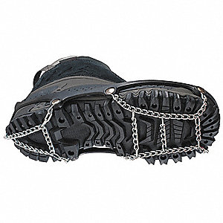
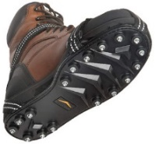
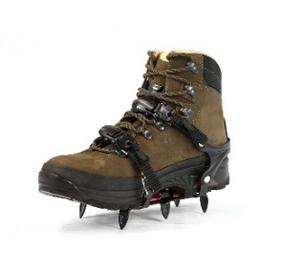





Winter Hazards: Fall Prevention Tips
gpcah.org
Plan to Prevent Falls
Ice Safety: Adopt new movements
for ice
Treat surfaces with Ice Melt
Walk Like a Penguin:
Take short, slow, flat-footed steps
Keep feet under your center of gravity
Keep hands and arms free to help adjust balance
Wear appropriate gear, no matter how long you plan to be outside
Prepare for ice in areas where water is known to accumulate
Bring phone and let people know where you are
Other Adjustments:
When exiting a car, step DOWN not OUT
Use handrails, avoid slopes
Keep your head up and don’t lean forward when walking
Use Additional Traction on Slippery Surfaces
coil
chain
spike
crampon
To Prevent Falling through Frozen Water Bodies
Prepare before walking/driving onto ice
Bring safety kit when on the ice to respond if someone falls through (dry clothes,
throw rope, hand warmer, whistle)
Check thickness every 150 ft. at a minimum
Depths given below should be doubled with refrozen ice
Make sure you have at least the minimum ice depth based on weight (depths for new ice only)
4”
5-7”
8-12”
15”
Visit gpcah.org for more information.
Double these depths if ice has been refrozen.

