Slide 1
Mental Health and Suicide Risk in Agricultural Communities
This presentation was developed to inform crisis center volunteers to better understand risk factors for Midwestern farmers and agricultural workers
This presentation was prepared using Emerging Issues funding as part of the Great Plains Center for Agricultural Health Grant (U54 OH 007548), supported by the Centers for Disease Control and Prevention/National Institutes for Occupational Safety and Health.
Originally prepared by Jenna Gibbs and Rima Afifi, for CommUnity Crisis Services In-Service Training, August 2019

Slide 2
Mental Health and Suicide Risk in Agricultural Communities
Part 1: Understanding Farmers
This presentation was developed to inform crisis center volunteers to better understand risk factors for Midwestern farmers and agricultural workers
This presentation was prepared using Emerging Issues funding as part of the Great Plains Center for Agricultural Health Grant (U54 OH 007548), supported by the Centers for Disease Control and Prevention/National Institutes for Occupational Safety and Health.
Originally prepared by Jenna Gibbs and Rima Afifi, for CommUnity Crisis Services In-Service Training, August 2019

Slide 3
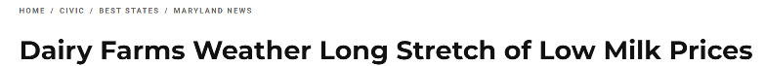
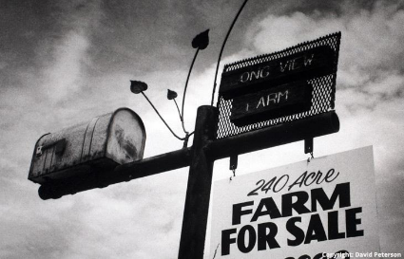
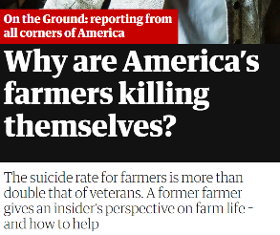
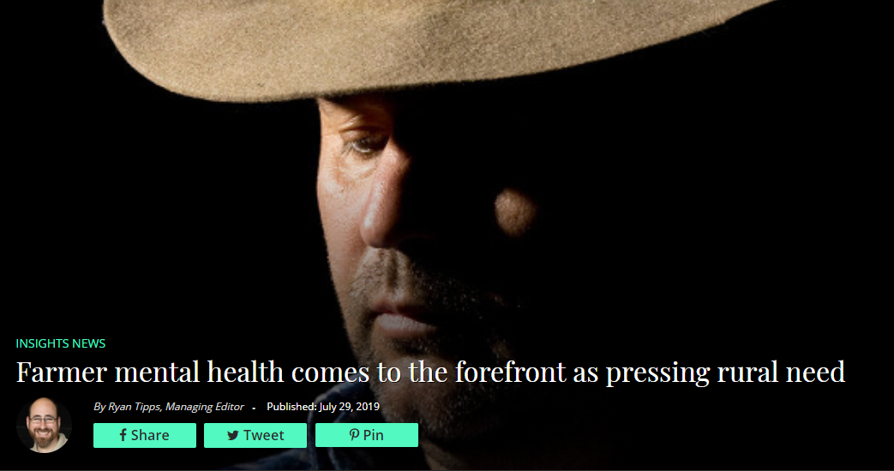
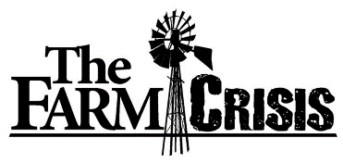
In the media . . . .
U.S. News, 2019
The Guardian, 2018
Ag Daily, 2019
Iowa Public Television, 2013
Notes:
Stories of hardship and concerns

Slide 4
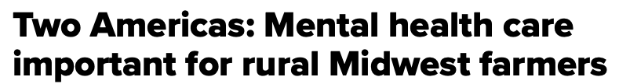
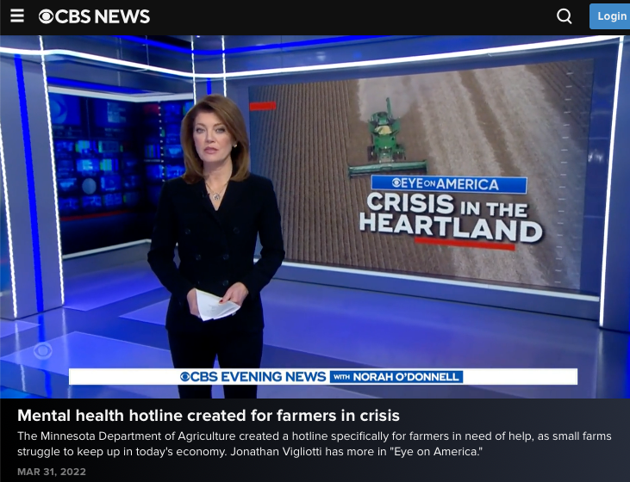



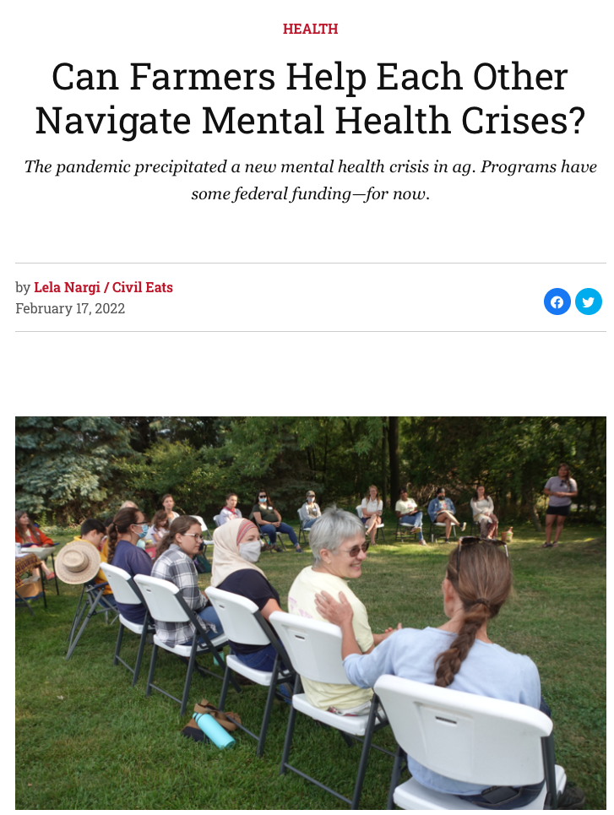
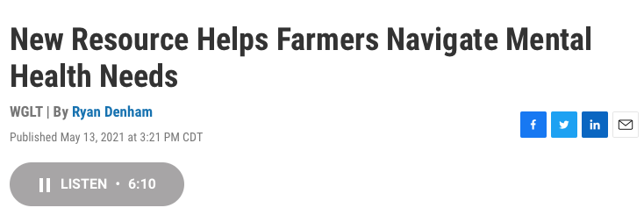
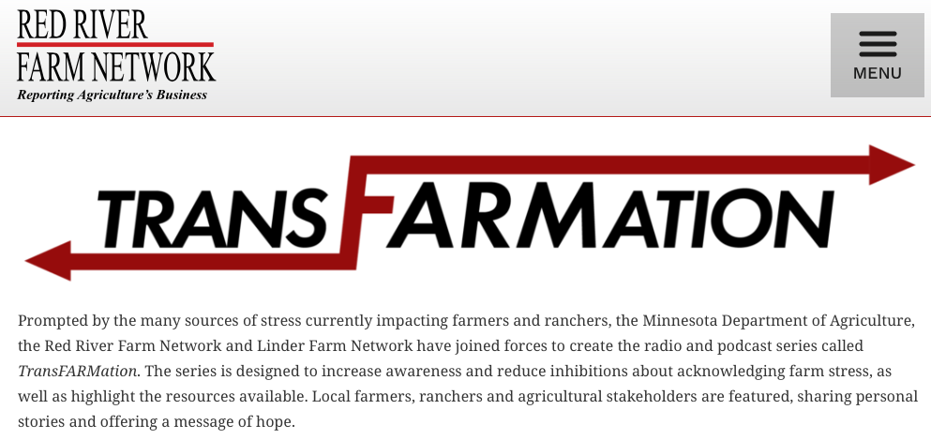

In the media . . . . Resources
Ag Daily, 2019
Notes:
Throughout the pandemic and beyond: Sharing of tools and resources to normalize the conversation
https://www.cbsnews.com/live/#x: Minnesota

Slide 5
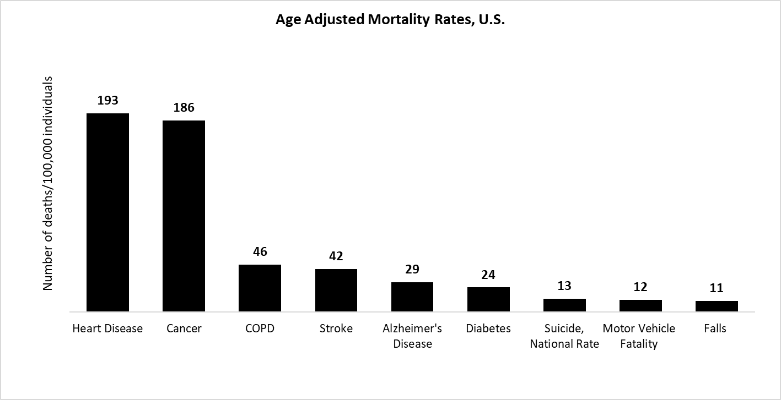

Centers for Disease Control and Prevention National Center for Health Statistics: Deaths in U.S., 2015-2016
Notes:
Ag forestry and fishing numbers – change title.
The National Farm Medicine Center in Marshfield, Wis., tracked farm suicides during the 1980s in the Upper Midwest, the region most affected by the farm crisis, to try to better understand the relationships between the farm economy and suicide. They found that 913 male farmers in the region committed suicide during that decade, with rates peaking in 1982 at 58 suicides for every 100,000 male farmers and ranchers. Compare that with this year’s CDC report, which found that current national suicide rates for people working in agriculture are 84.5 per 100,000 overall, and 90.5 per 100,000 among males. This means that suicide rates among male farmers are now more than 50 percent higher than they were in 1982, at the peak of the farm crisis.
2017 Rate for heart disease, general population is 193 per 100,000; Cancer is 186 per 100,000; COPD is 46 per 100,000; Stroke is 42 per 100,000; Alzheimer’s disease is 29/100,000. (Rates from 2017 CDC Data) https://www.cdc.gov/nchs/data/hus/2017/019.pdf
One surprising statistic to many was suicide rates for workers in the agricultural, fishing and forestry industry are the highest of any other occupational group, exceeding rates in other high-risk populations, including veterans.
5

Slide 6


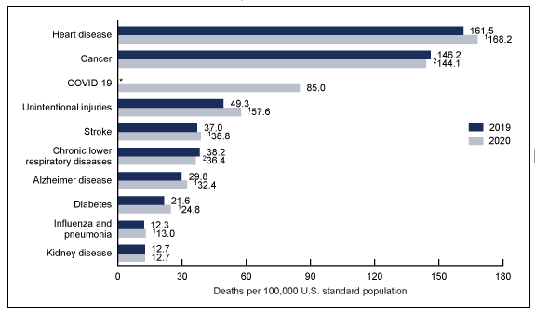
Notes:
Ag forestry and fishing numbers – change title.
The National Farm Medicine Center in Marshfield, Wis., tracked farm suicides during the 1980s in the Upper Midwest, the region most affected by the farm crisis, to try to better understand the relationships between the farm economy and suicide. They found that 913 male farmers in the region committed suicide during that decade, with rates peaking in 1982 at 58 suicides for every 100,000 male farmers and ranchers. Compare that with this year’s CDC report, which found that current national suicide rates for people working in agriculture are 84.5 per 100,000 overall, and 90.5 per 100,000 among males. This means that suicide rates among male farmers are now more than 50 percent higher than they were in 1982, at the peak of the farm crisis.
2017 Rate for heart disease, general population is 193 per 100,000; Cancer is 186 per 100,000; COPD is 46 per 100,000; Stroke is 42 per 100,000; Alzheimer’s disease is 29/100,000. (Rates from 2017 CDC Data) https://www.cdc.gov/nchs/data/hus/2017/019.pdf
One surprising statistic to many was suicide rates for workers in the agricultural, fishing and forestry industry are the highest of any other occupational group, exceeding rates in other high-risk populations, including veterans.
6

Slide 7

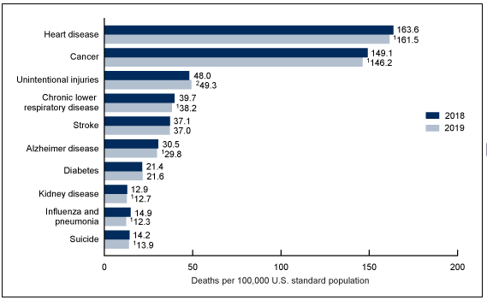
Notes:
Ag forestry and fishing numbers – change title.
The National Farm Medicine Center in Marshfield, Wis., tracked farm suicides during the 1980s in the Upper Midwest, the region most affected by the farm crisis, to try to better understand the relationships between the farm economy and suicide. They found that 913 male farmers in the region committed suicide during that decade, with rates peaking in 1982 at 58 suicides for every 100,000 male farmers and ranchers. Compare that with this year’s CDC report, which found that current national suicide rates for people working in agriculture are 84.5 per 100,000 overall, and 90.5 per 100,000 among males. This means that suicide rates among male farmers are now more than 50 percent higher than they were in 1982, at the peak of the farm crisis.
2017 Rate for heart disease, general population is 193 per 100,000; Cancer is 186 per 100,000; COPD is 46 per 100,000; Stroke is 42 per 100,000; Alzheimer’s disease is 29/100,000. (Rates from 2017 CDC Data) https://www.cdc.gov/nchs/data/hus/2017/019.pdf
One surprising statistic to many was suicide rates for workers in the agricultural, fishing and forestry industry are the highest of any other occupational group, exceeding rates in other high-risk populations, including veterans.
7

Slide 8

November 2018: CDC MMWR: Suicide Rates by Occupational Group – 17 States, 2012 and 2015
Notes:
Occupational and Suicide Risk in Colorado found that AFF was 476/100,000, which is much higher than this rate, and that over half of these were firearms related.
https://onlinelibrary.wiley.com/doi/full/10.1002/ajim.22228
Alaska, Colorado, Georgia, Kentucky, Maryland, Massachusetts, New Jersey, New Mexico, North Carolina, Ohio, Oklahoma, Oregon, Rhode Island, South Carolina, Utah, Virginia, and Wisconsin.
8

Slide 9
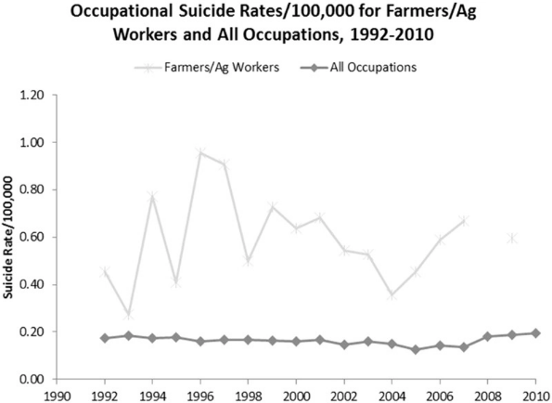

Trends of Occupational Suicide in Farmers and Agricultural Workers, 1992-2010
https://onlinelibrary.wiley.com/doi/10.1111/jrh.12245
Notes:
Occupational and Suicide Risk in Colorado found that AFF was 476/100,000, which is much higher than this rate, and that over half of these were firearms related.
https://onlinelibrary.wiley.com/doi/full/10.1002/ajim.22228
Graph is from https://onlinelibrary.wiley.com/doi/epdf/10.1111/jrh.12245
9

Slide 10








Common Stressors – Pre-Pandemic
16% Workload/Time Mgmt.
7% Politics/Policy
7% Aging
8% Family/Personal
45% Finances
Ag Daily, 2019
8% Health and Safety
22% Climate/Weather
GPCAH Needs Assessment Survey 2018-19 (MO, IA, OH)

Slide 11
Additional Common Stressors (others worth mentioning)
Legacy Pressure
Public Perception of Agriculture
Extremist/Advocacy Groups
Lack of Farming Knowledge (New Farmers)
Feeling Isolated
Ag Daily, 2019
ISASH Conference Mental Health Networking Reception, 2019

Slide 12
Where ag workers seek help
Talk about it with a trusted source: 31%
Seeks professional advice: 15%
Religion/Faith community: 13%
Does nothing: 11%
Hobbies/Entertainment/Food &Alcohol: 8%
Intrinsic (Cuts costs, humor, self-study): 7%
Ag Daily, 2019
Seeks more information: 5%
GPCAH Needs Assessment Survey 2018-19 (MO, IA, OH)

Slide 13

What is being done to end stigma?
ISASH Conference Mental Health Networking Reception, 2019

Slide 14
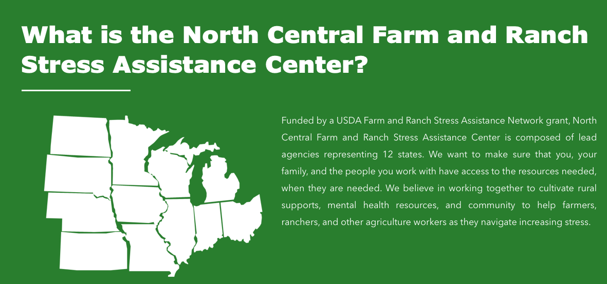
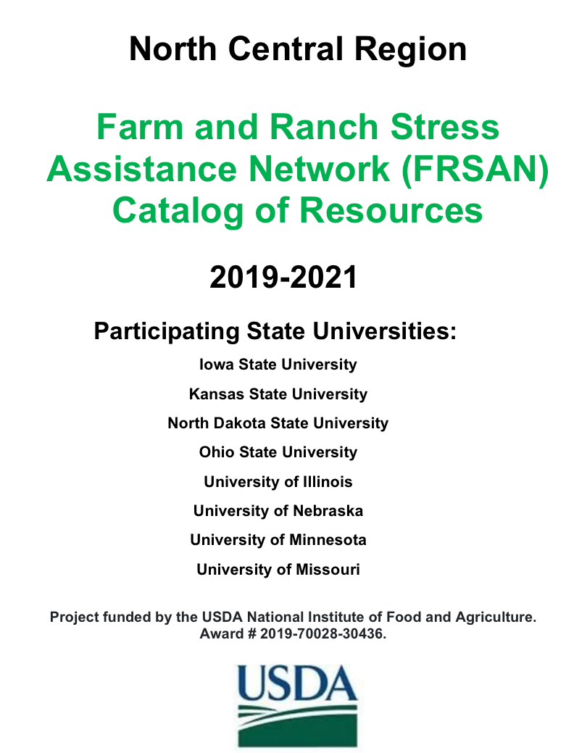


Reaching Farmers… Normalizing the Conversation
https://farmstress.org
https://www.rrfn.com/transfarmation/
Farm and Ranch Stress Assistance Network (RFSAN)

Slide 15

Notes:
“You know, farming looks mighty easy when your plow is a pencil, and you’re a thousand miles from the corn field.” – Dwight D. Eisenhower
Include American F Bureau Log
15

